Slide 1

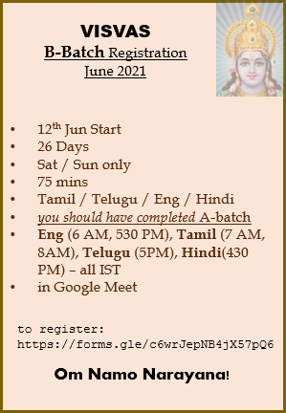
12th Jun Start
26 Days
Sat / Sun only
75 mins
Tamil / Telugu / Eng / Hindi
you should have completed A-batch
Eng (6 AM, 530 PM), Tamil (7 AM, 8AM), Telugu (5PM), Hindi(430 PM) – all IST
in Google Meet
VISVAS
B-Batch Registration
June 2021
to register:
https://forms.gle/c6wrJepNB4jX57pQ6
Om Namo Narayana!

Slide 2
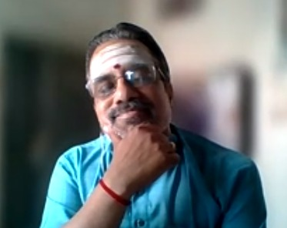
Pledge
Mrs. Sripriya Ravishankar
Felicitation to Guruji
Mrs. Sudha
BN Shankar
Felicitation to Guruji
Damodaran
Rajie Raman
Certificate Receiving
BS Mahalakshmi
N Shankar
We welcome one and all!
Om Namo Narayana!
Pledge
Mrs. Sripriya Ravishankar
Felicitation to Guruji
Mrs. Sudha
BN Shankar
Felicitation to Guruji
KSV Sundaram
Rajie Raman
Certificate Receiving
BS Mahalakshmi
Priya Krishnamurthy
Damodaran
We welcome one and all!
Om Namo Narayana!
VISVAS
B41 – Valedictory
10 Oct 2021, Sunday
7 – 8:30 AM IST
VISVAS
B41 – Valedictory
10 Oct 2021, Sunday
7 – 8:30 AM IST

Slide 3

visvas.helpdesk@gmail.com
We have helpdesk now!
When are new batches starting?
My roll number is 1298 – I haven’t received my certificate
Can we have special satsangs for Ekadasi?
I want to be volunteer
…

Slide 4
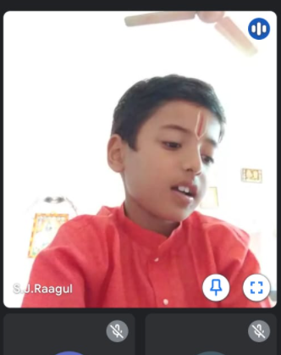
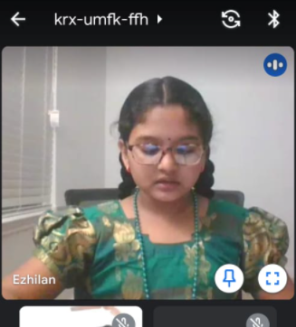
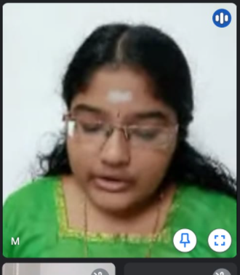
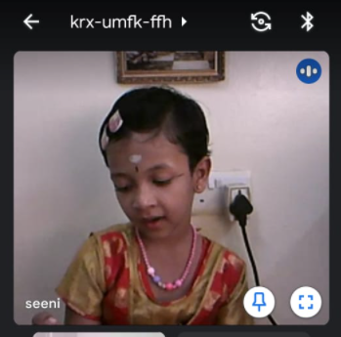
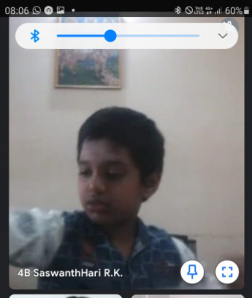
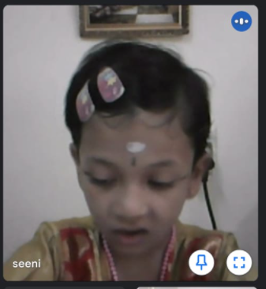
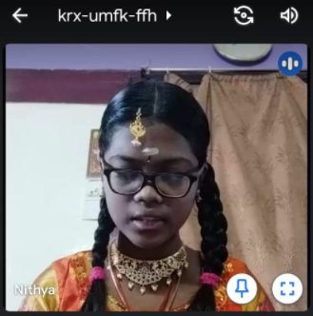
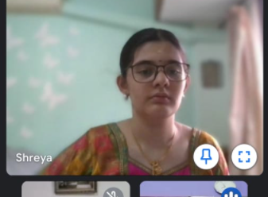
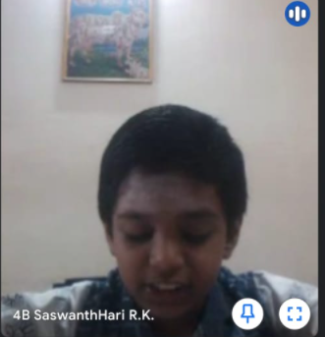

Slide 5
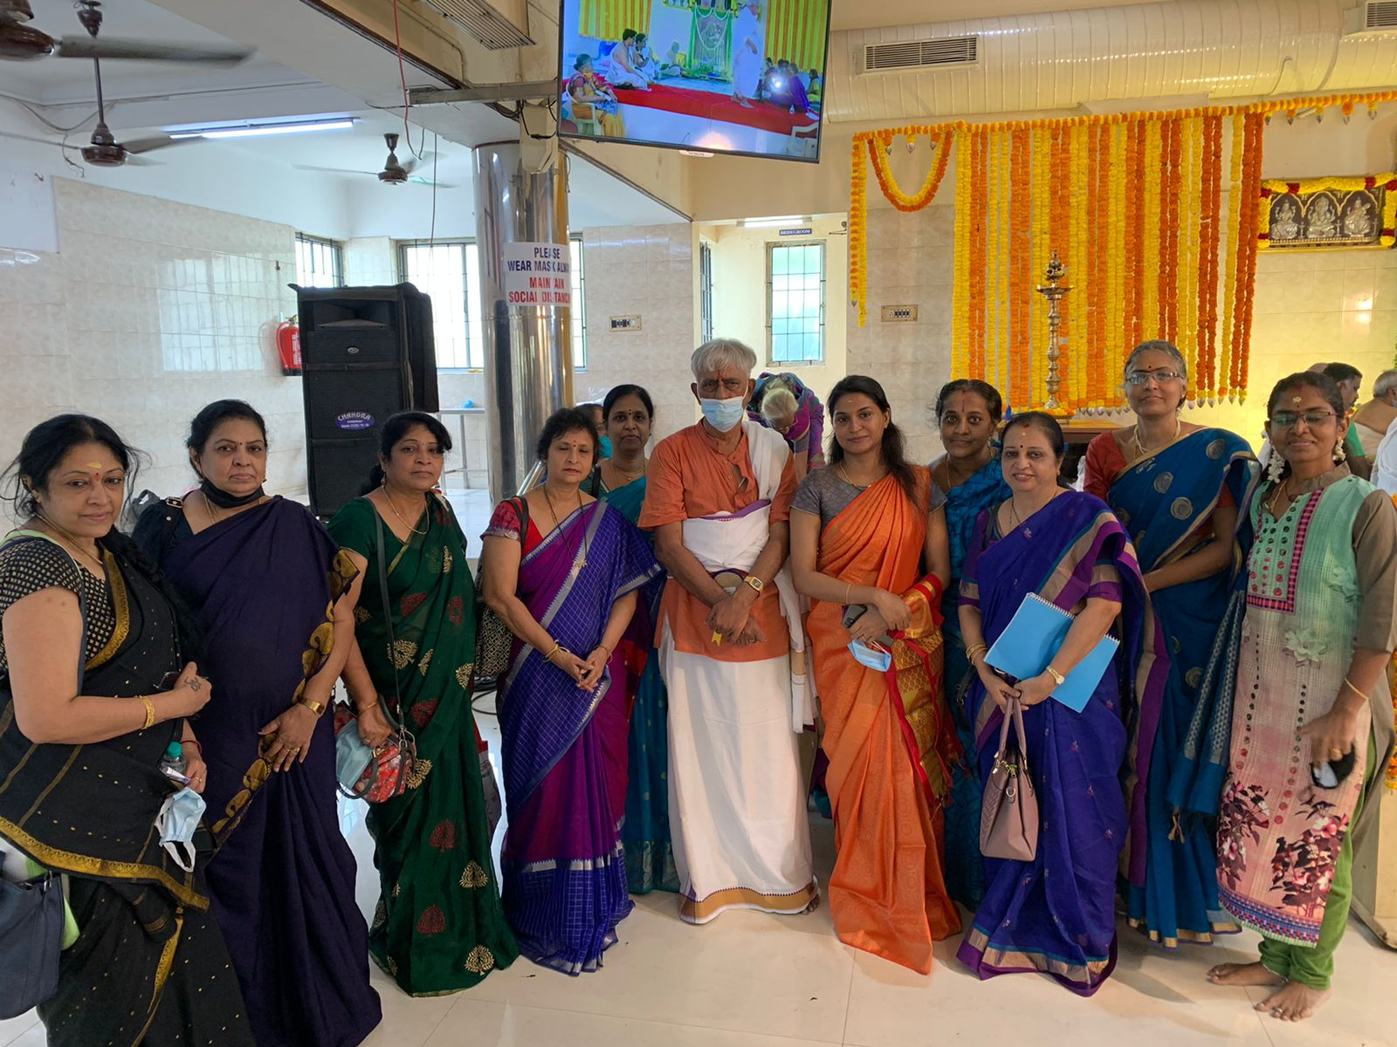
Padma
Kowsalya
Sucharitha
Usha Bala
Sridhar Sir
Veena
Sumathi K

Slide 6
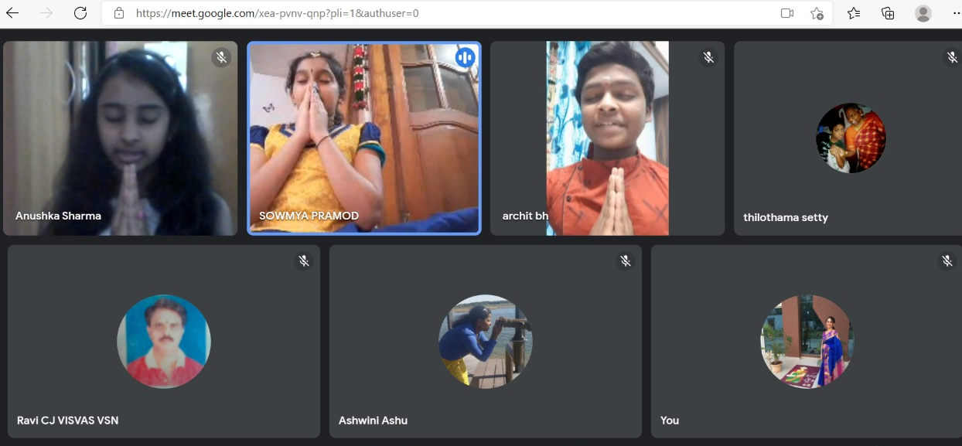

Slide 7
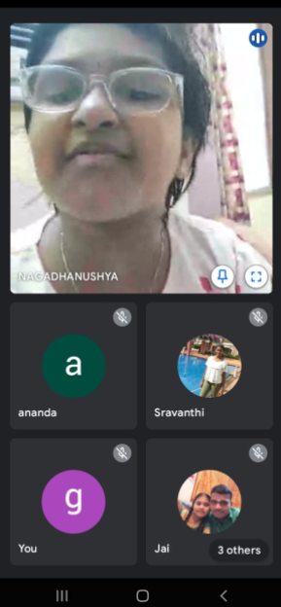
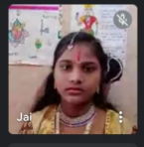

Slide 8
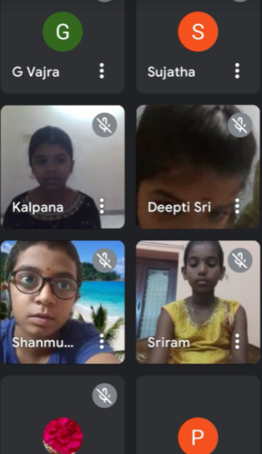
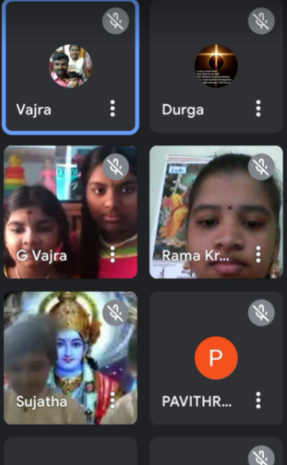
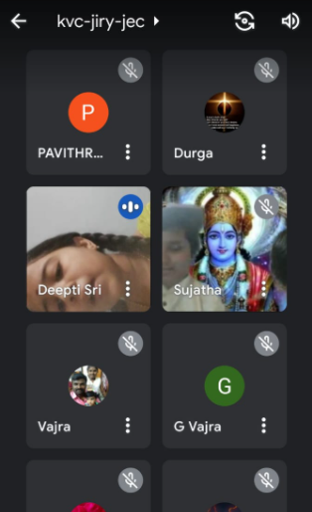
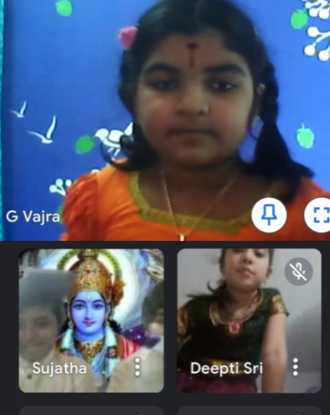

Slide 9
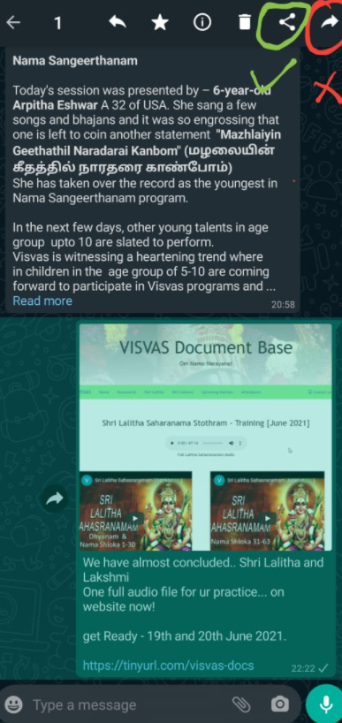
When I forward – only picture goes not the text.. ☹
We will solve ur issue!
Don’t FORWARD!
Hit Share (as in pic)
Select WhatsApp
Select contacts that you like / love to send
DONE!

Slide 10
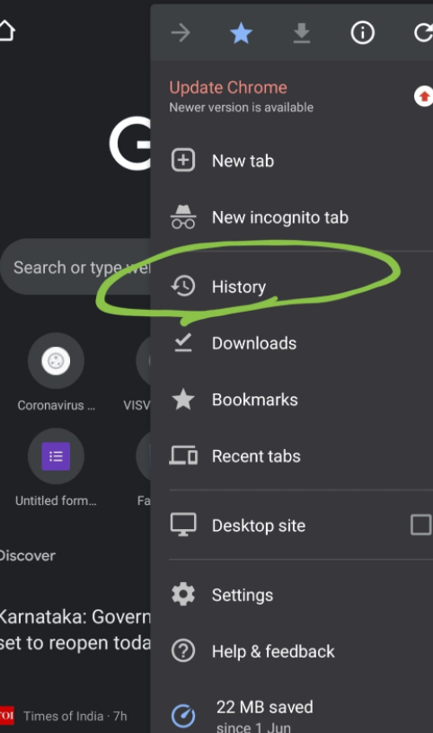
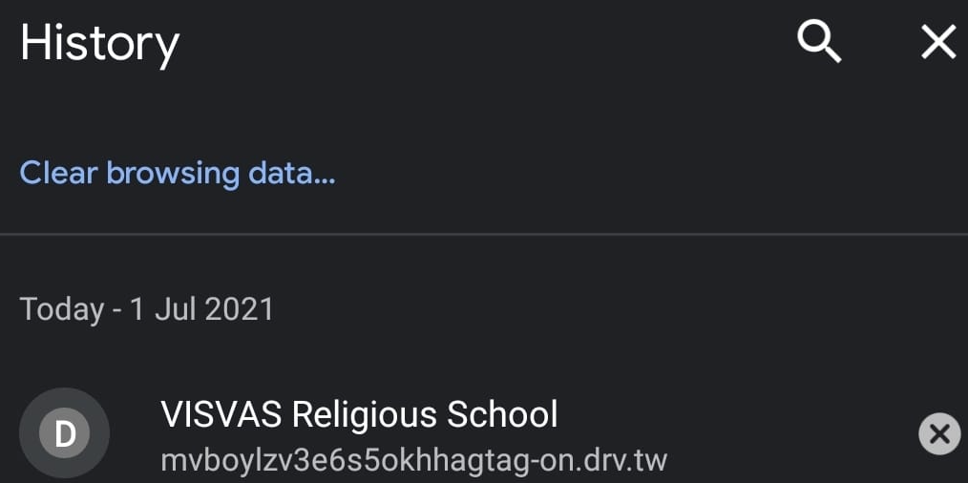
1
2
Mobile browser – open settings -> History -> Clear browsing data
Reload the link / url / page. Laptop browser – Shift + F5 (or) Ctrl + F5

Slide 11
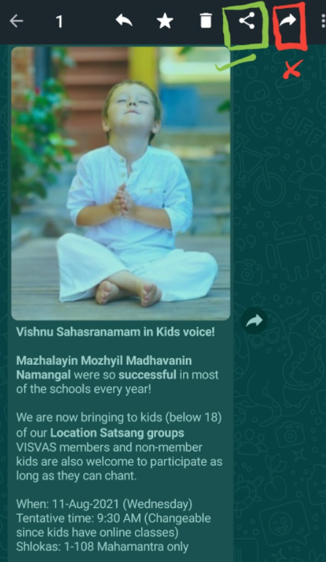
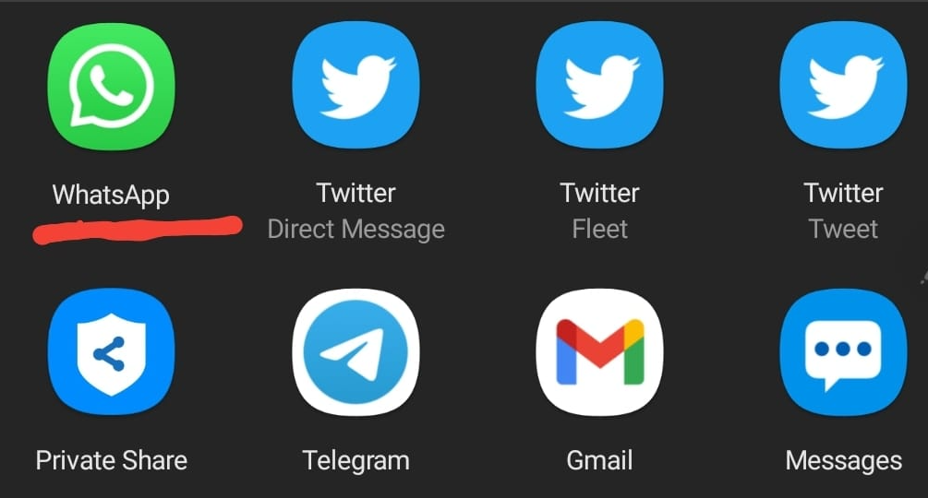

1
2
3

Slide 12

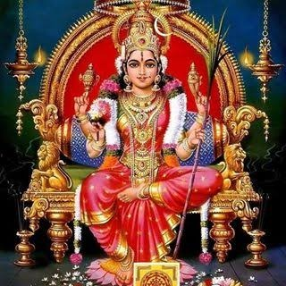

Om Shri Maathre Namaha!
VISVAS presents
1-week Sahasranama Stotram class
Timings: 10 AM – 10:45 AM IST
Date: 30-May-2021
VISVAS Welcomes you all for the Lalitha & Lakshmi Sahasranama Stothram class
Agenda:
Starting Prayer
Welcome Address
Guidelines for Online Classes
Ending Prayer
ZOOM Join link: https://us02web.zoom.us/j/4490291210?pwd=UHM0eFQ3b1ZuMENmcEZtMEMwZmNFdz09
ZOOM APP: Meeting ID: 449 029 1210 Passcode: visvas
5-D principles of VISVAS: Devotion, Discipline, Dedication, Determination, Development

